Slide 1
Where should I become a rideHAILING driver
Team Covfefe
Dan Fox, Farzad Khatoonabadi, Pravin Venkatraman

Slide 2
Agenda
Demographics
Establishments
Employees
Wages
Safety
Conclusion

Slide 3
Demographics

Slide 4
Establishments

Slide 5
Employees

Slide 6
Wages

Slide 7
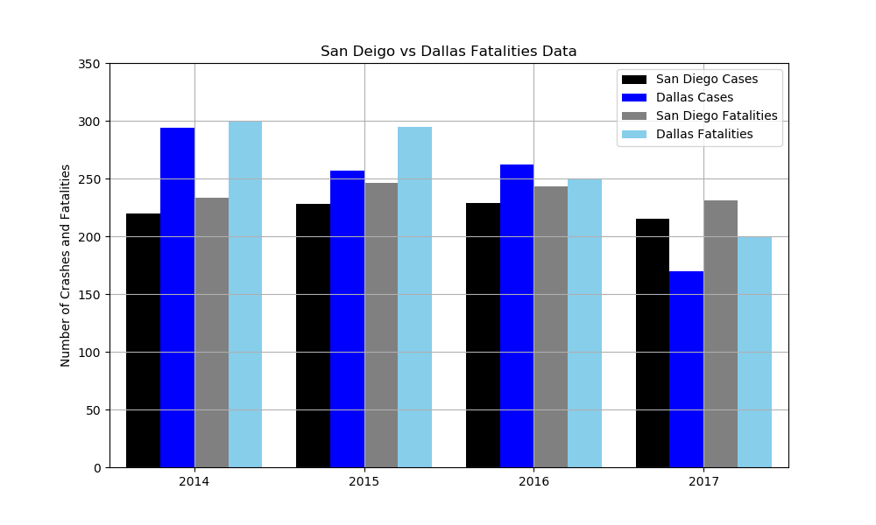
Safety

Slide 8
conclusion
Based on the data, it is not a good idea to enter the transportation business based on the number of existing companies, wages, and higher potential of death while driving.
Covfefe

